Slide 1

Strength Through Unity Tour
Kimberly A. Mlinaz, JD
DAF
Negotiation & Dispute Resolution
STRENGTH STARTS WITHIN

Slide 2

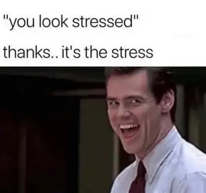
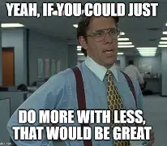
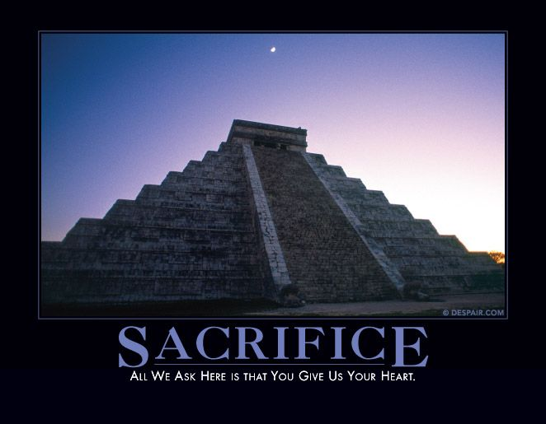
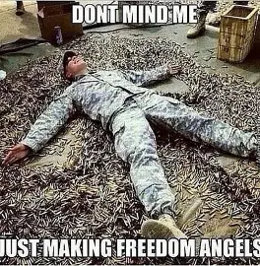
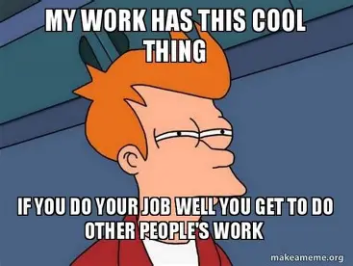

Slide 3

Stress Lowers Our “Water Level”
Peer Friction
Miscommunication
Frustration
High Conflict Behaviors

Slide 4
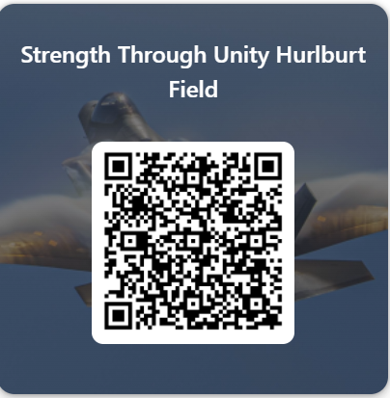
Help Us Help You
Checking the Water Level
This form is set to “anyone can respond,” allowing for anonymous response.
Your name and email address are not automatically collected.

Slide 5
STEP 01
Disrupt the pattern with a break or change of surroundings
STEP 03
Brainstorm with a future focus on options or possibilities
STEP 05
Be a Wingman through challenging times
Get
Unstuck
Regain
Direction
Talk through Obstacles
Support Their
Progress
Recharge
Helping Teammates Adapt & Thrive
STEP 02
Use past successes to build positive momentum
STEP 04
Identify potential barriers that could derail progress

Slide 6
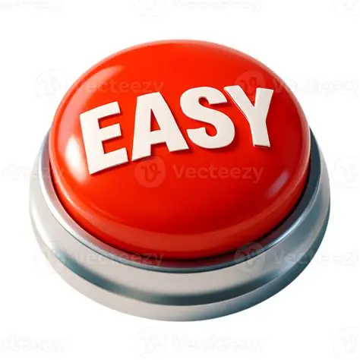
Quick Reaction Option
Be Present
“I can see why that would be hard. I’d like to hear more if you’re willing to tell me.”
Acknowledge
the Signal
Use Silence

Slide 7

Simulation
Your unit just got back from your third short notice deployment and you’re all spent. You and a teammate are directed to inventory a bunch of supply crates before you can go home. Not only is your teammate not really helping, but they are making a lot of mistakes with the things they are doing. You want to get home to your family, but when you try to say something, they nearly bite your head off. At this rate, you’ll be here until midnight. What do you do?
Break the Pattern
Build Momentum
Option Building
Talk through Obstacles

Slide 8
Lead with the point, not the panic
Tactical pause
Have the information
Think about what they need to be able to help you
BULF: State the readiness impact
Effective Comms Up the Chain
Why does it matter to the mission
Make the tradeoff real
“My focus is split between three tasks, and I’m at risk of failure on one of them.”
REQUEST: Small, specific, actionable
Make it easy to help
“Can you give me five minutes to confirm which tasks come first?”

Slide 9
Hurlburt Contact Information
NDR Program Manager:
Ms. Jean Masters
jeanmasters@us.af.mil
(850) 884-8800

Slide 10
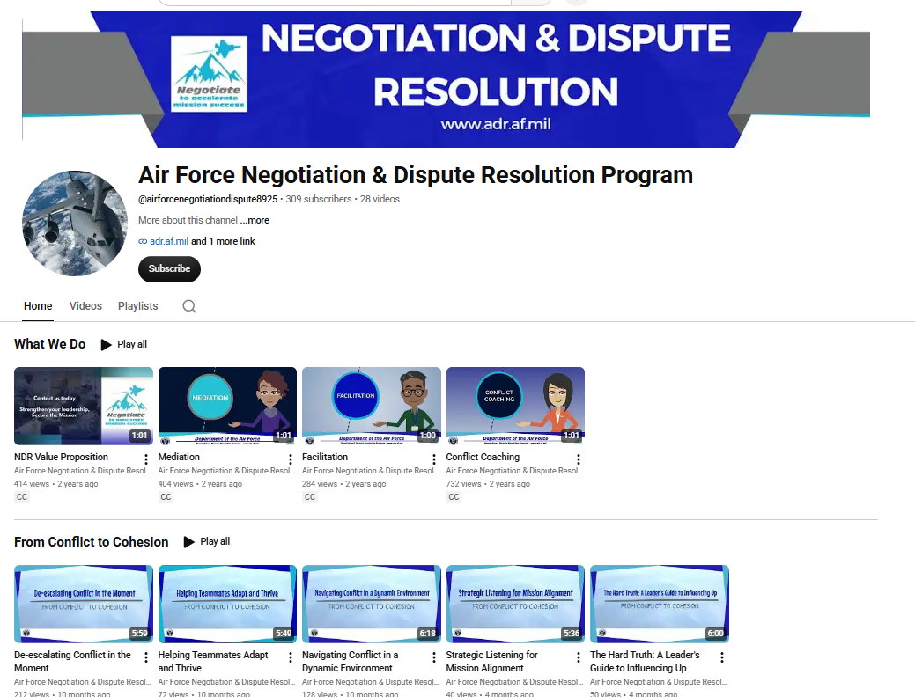


https://www.youtube.com/@airforcenegotiationdispute8925
https://www.af.mil/About-Us/Coaching/
https://www.airuniversity.af.edu/AFNC/

Slide 11
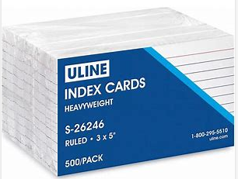
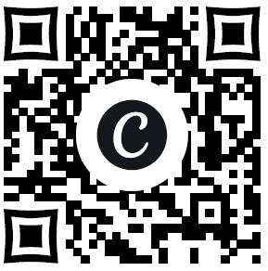
Help Us Help You
Card 1: What is the BLUF & tactical request for a conversation I need to have. (Keep This)
Card 2: What is the biggest thing that might get in my way when I try to address this issue? (Turn this In)
No endorsement intended.
To download the slides or capture the resource links, click here:

Slide 12
Questions?

